Slide 1
Steepbank Primary Extraction
Bitumen Recovery Prediction Model –
Function Approximation
Paul Kang, Ore Quality Engineer,
Apr 14th, 2020

Slide 2
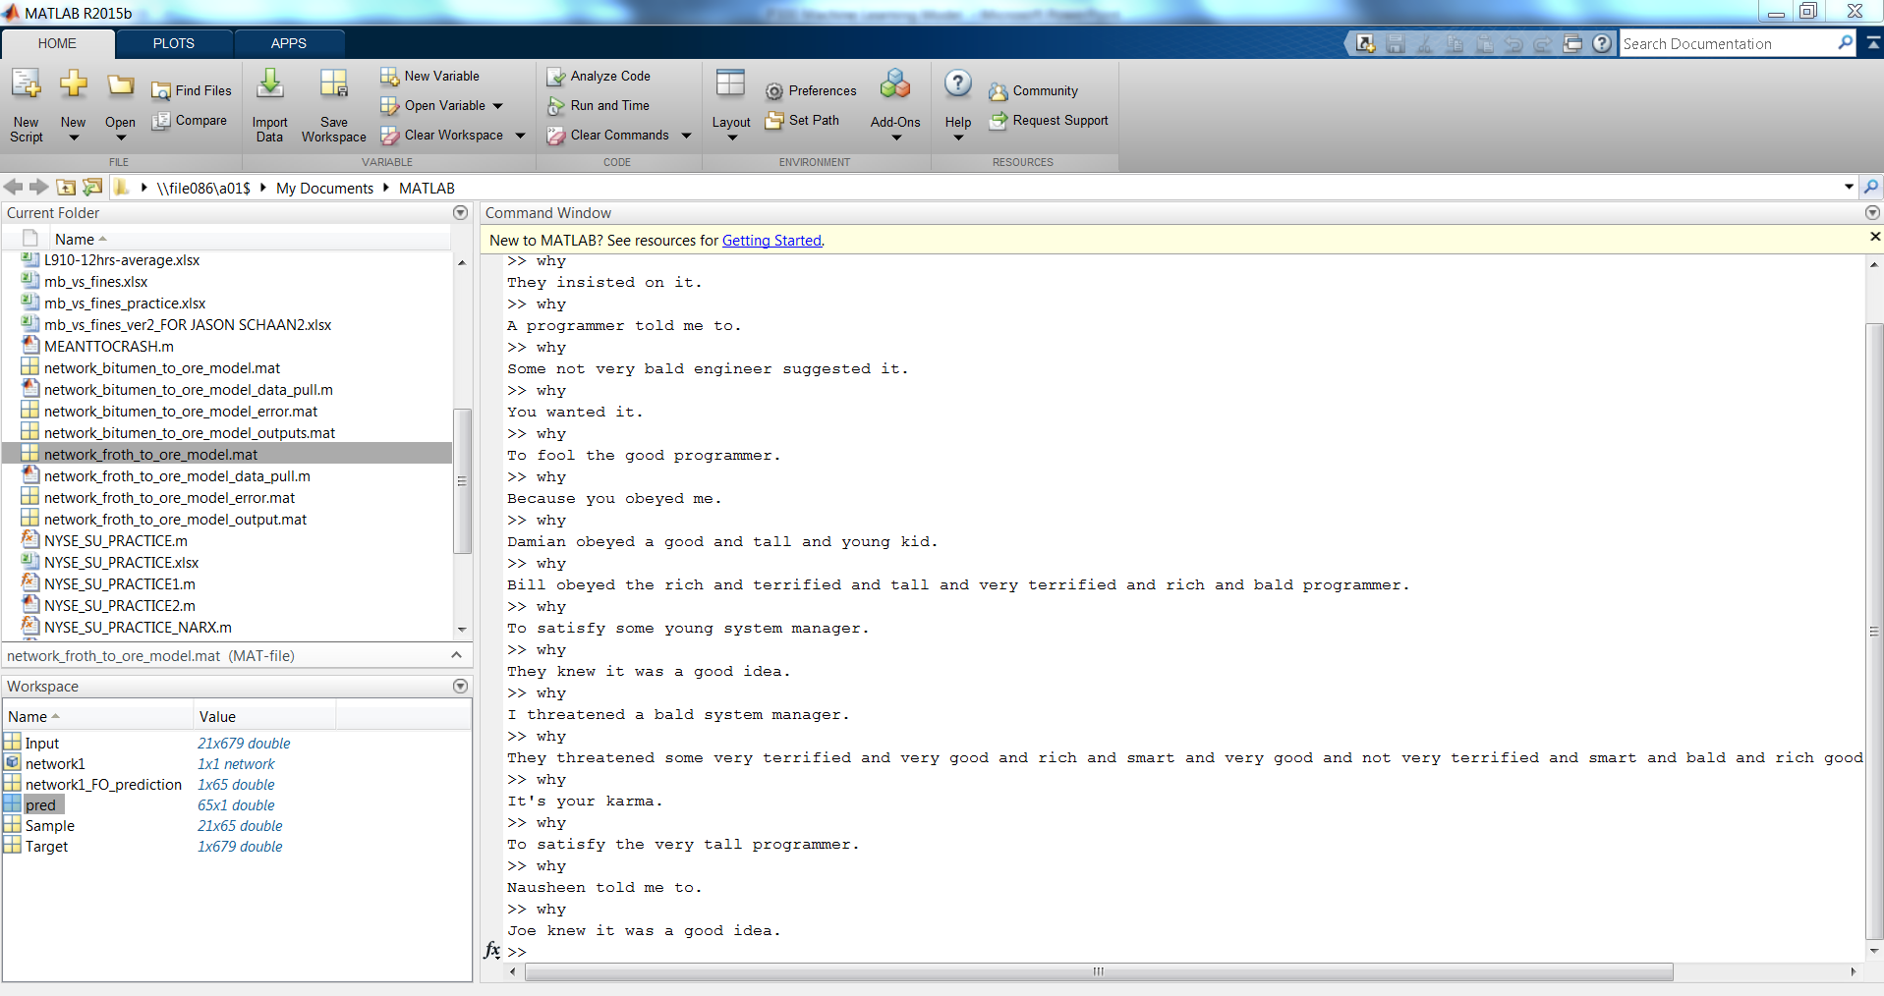

Safety Moment – Mental Health While Programming
Make a balance between brain work and physical work, otherwise you end up expressing passive aggressiveness towards to poor RAM and CPU processors
Good posture while sitting, office physical stress is something not to be overlooked!!!
Rest well while resting! Building good mental and physical condition is another form of good performance towards work (and you get fresh ideas that sometimes work)
Be a good friend with Google and Stack Overflow

Slide 3
Steepbank – Bitumen Prediction Model Motivation
Develop a deeper understanding into factors that affect production quantity and quality
Use extraction process parameters and Ore Quality parameters to determine expected froth / bitumen production and its quality from Primary Extraction (Only on L9 for now)
Advanced statistical analysis is used to analyze how each extraction process parameters are interacting each other, and their convolutionary effect on bitumen production.
Partial Least Regression – PLS is used to develop linearized statistical equation that predicts the bitumen to ore ratio
Neural Network (Function Approximation) –Neural Network is used to develop non-linear equation that predicts the bitumen to ore ratio
Neural Network (Function Approximation) –Neural Network is used to develop non-linear statistical equation that predicts the froth to ore ratio
In this study, 25 different input variables are used and studied in both approaches. List of input variable is mentioned at the subsequent slide.
The target is to correctly predict bitumen-to-ore ratio (1 target Vs 25 input variable) with the highest R² with lowest Mean Squared Error (MSE) and Mean Absolute Percentage Error (MAPE)

Slide 4
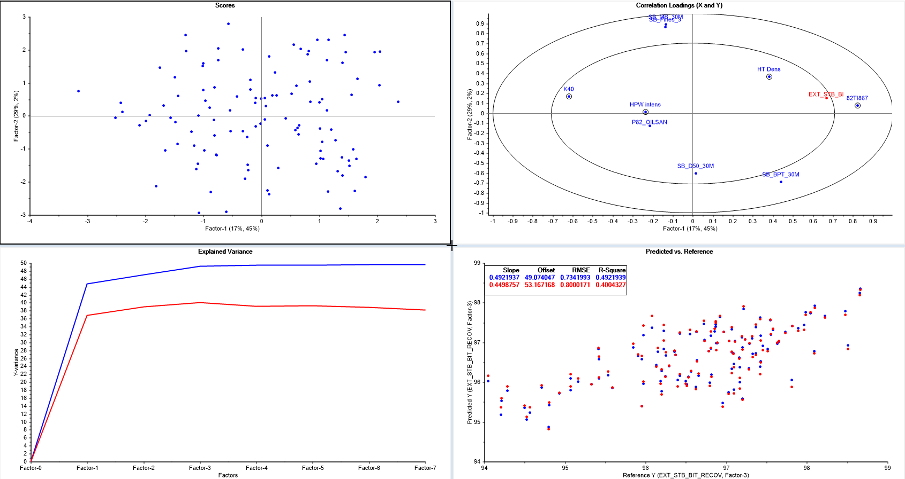
Steepbank – PLS model (linear regression approach)
Came up with PLS model that yields R² of 0.49 (Best), target of recovery
Not a good model

Slide 5
Steepbank – Bitumen/Ore Neural Network model
Training data period: 2019 Jan – 2020 Jan
Data Partition ratio: 678 data point (shift basis)
Training: 70%
Validation: 15%
Test: 15%
Started with 25 variables (Plant 82 and 300 inclusive), but trimmed down to 24 variables.
Randomized data set, iterative training (MATLAB programmed) enabled to reach maximum overall R (“All: R”)
Bias and Weight matrix needs to be reviewed, input layer sensitivity analyzed to determine which variables to exclude and include.
Tested Paul Kang’s model to 2020 March dataset (completely different dataset by differing time range, no filtering has been done to the new dataset)

Slide 6
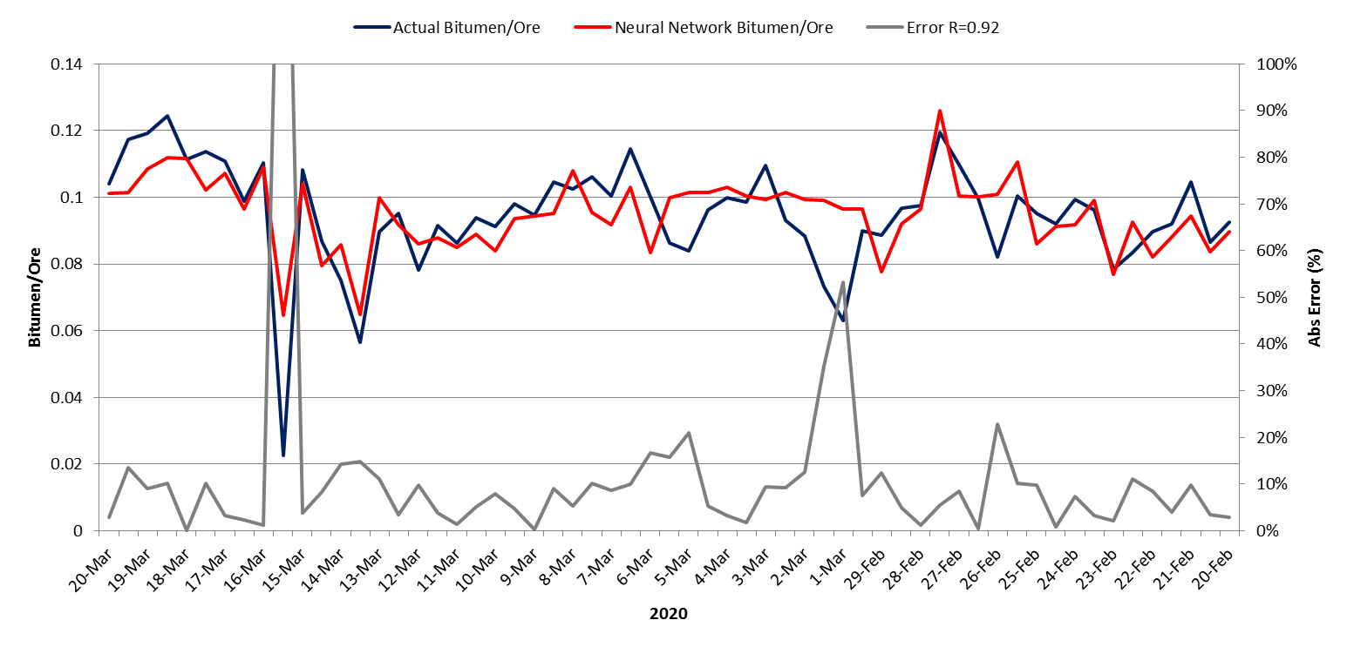
Steepbank – Bitumen/Ore Neural Network model, Test Dataset Results
Model showing indirectional behavior

Slide 7
Steepbank – Bitumen/Ore Neural Network model, Variables (in progress)
# | Input variables considered | Bias Units
1 | SB_Tonnage | Work to be completed
2 | MBI
3 | % Fines
4 | D50
5 | HPW Temperature
6 | P300 Bypass usage %
7 | Middlings density
8 | P300 K40
11 | Froth Temperature
12 | Sep cell underflow
13 | Sep cell underflow % speed
14 | Feed HPW
15 | Middlings flow
16 | HT Density
17 | HT Temperature
18 | HPW Intensity (USG/T)
20 | Chlorine (ppm)
21 | % Bitumen in feed
22 | Froth Density
23 | Froth Bitumen %
24 | Froth Mineral %
25 | Froth Water %
Target | Bitumen to Ore

Slide 8
Steepbank – Bitumen/Ore Neural Network model, Challenges
Some datapoints from test data set is showing reverse-directional behavior from the model output.
Although the model is not overfitting/underfitting (Valid.R: 0.935, Test.R: 0.914), it needs further brush up as the new dataset for testing is showing 8.6% of MAPE
Bitumen to Ore ratio model does not add large value to be implemented as part of EOA, as the froth BMW assay has -12hrs delay from the present operation.
Continued examination of, and pre-processing for dataset is being done. Need for further testing on those conditional filters.
However, this will have value examining / engineering troubleshooting incidents how plant was operating, what was the actual feed quality Vs Mine model deviation depending on the plant & model reaction.

Slide 9
Steepbank – Froth/Ore Neural Network model
Training data period: 2019 Jan – 2020 Jan
Data Partition ratio: 678 data point (shift basis)
Training: 70%
Validation: 15%
Test: 15%
Started with 22 variables (Plant 82 and 300 inclusive), but cutting corners, trimmed down to 20 variables.
Randomized data set, iterative training (MATLAB programmed) enabled to reach maximum overall R (“All: R”)
Bias and Weight matrix needs to be reviewed, input layer sensitivity analyzed to determine which variables to exclude and include.
Tested Paul Kang’s model to 2020 March dataset (completely different dataset by differing time range, no filtering has been done to the new dataset)

Slide 10
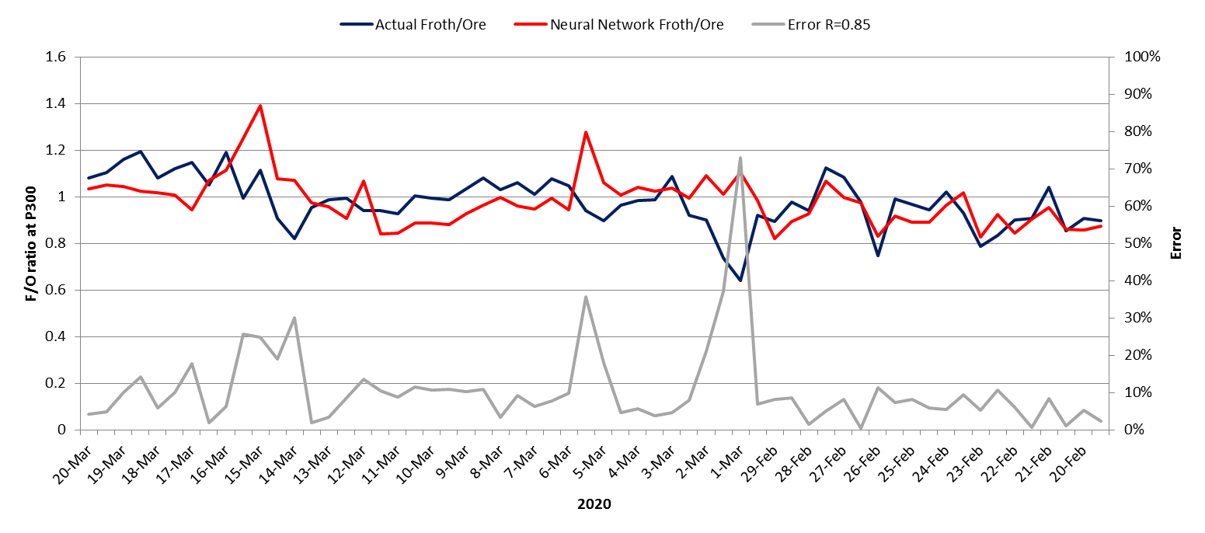
Steepbank – Froth/Ore Neural Network model, Test Dataset Results
Model showing indirectional behavior

Slide 11
Steepbank – Froth/Ore Neural Network model, Variables (in progress)
# | Input variables considered | Bias Units
1 | SB_Tonnage | Work to be completed
2 | MBI
3 | % Fines
4 | D50
5 | HPW Temperature
6 | P300 Bypass usage %
7 | Middlings density
8 | P300 K40
11 | Froth Temperature
12 | Sep cell underflow
13 | Sep cell underflow % speed
14 | Feed HPW
15 | Middlings flow
16 | HT Density
17 | HT Temperature
18 | HPW Intensity (USG/T)
20 | Chlorine (ppm)
21 | % Bitumen to P300
22 | Froth Density
Target | Froth to Ore

Slide 12
Steepbank – Froth/Ore Neural Network model, Challenges
Some datapoints from test data set is showing reverse-directional behavior from the model output.
Model needs some improvement (Valid.R: 0.833, Test.R: 0.883), it needs further brush up as the new dataset for testing is showing 11.7% of MAPE. Impact of such high MAPE will pose a risk to wrong recommendation move made to CROs, which its economical impact needs to be properly assessed.
Froth to Ore ratio model is adding large value to understand interaction of internal variables that leads to froth production behavior in P300. Further GPC (graphical process control) & Principal Component Analysis (PCA) chart is needed using Supervised Classification– (SVM is used for classification in this study) to visualize its interaction.
As a preliminary study, Variable importance will be assessed by examining bias vector from each hidden layers

Slide 13
Appendix
Paul Kang, Ore Quality Engineer,
Apr 14th, 2020

Slide 14
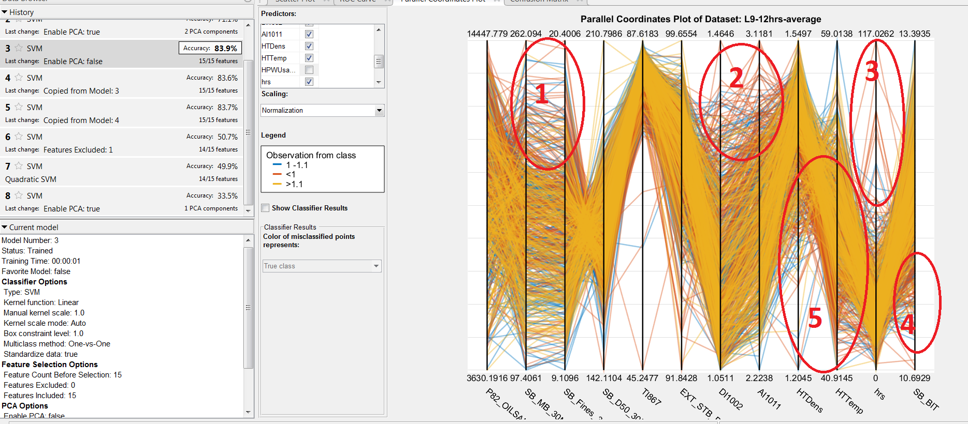
Steepbank – Froth/Ore Neural Network model, Parallel Coordinates Plot
ROC: 98% Confusion Matrix with FPR, TNR(False Positive Ratio, True Negative Ratio) is under study.

Slide 15
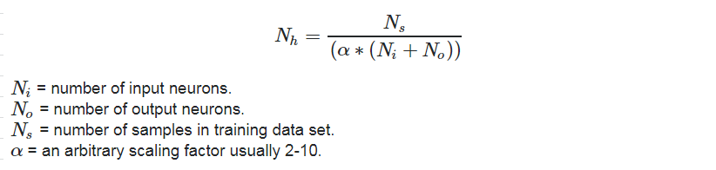
Steepbank – Bitumen/Ore Neural Network model Architecture
Number of hidden layers: Split the data into training, cross validation, and test sets, and train neural networks with 1, 2, and 3 hidden layers, then see which one has the lowest cross validation error to choose an architecture
Work is in progress on choosing the architecture. Running combinations on which one to choose.

